Slide 1
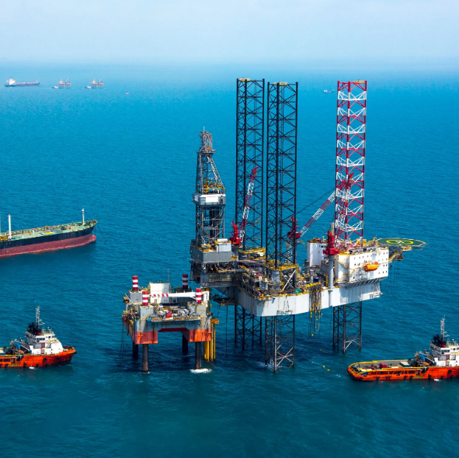
CLASSIFICATION OF UNDESIRABLE EVENTS IN OIL WELL OPERATIONS (DOWNSTREAM)
GROUP 1
GILBERT VICTOR (Lead)
OVIE IBOYITIE
DANIEL NGWU
PAUL NWACHUKWU
DATE 22nd AUGUST, 2022

Slide 2
OUTLINE
PROBLEM STATEMENT
WHY PROVIDE A SOLUTION TO PREDICTING WELL CONDITIONS
PROJECT METHODOLOGY
MACHINE LEARNING WORKFLOW
MODEL EVALUATION
CONCLUSION

Slide 3
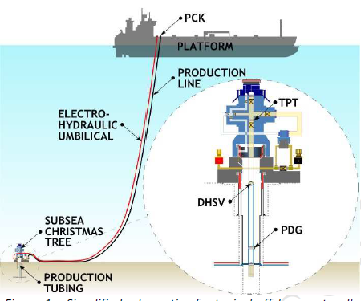
PROBLEM STATEMENT
Oil wells are prone to undesirable conditions such as Severe Slugging, Flow Instability, etc.
Well intervention process takes time and a lot of resources.
The detection and predictions of unwanted occurrences in oil and gas wells can lower maintenance costs and help minimize production losses, environmental disasters, and human fatalities.
The identification, prediction and classification of unwanted unpleasant events in Oil well operations are task that are important and carried out and/or monitored by humans .
The task of responding to abnormal events in a process include the prompt detection of an abnormal event, the diagnosis of its underlying causes, and the implementation of the necessary control decisions and actions to return the process to a normal, secure, and functional condition.
Simplified schematic of a typical offshore naturally flowing well.
Notes:
Downstre

Slide 4


WHY PROVIDE A SOLUTION TO PREDICTING WELL CONDITIONS
REDUCES DOWNTIME
REDUCES REPAIR COST
Reduces the time spent when oil well fail completely
Maintenance repairs in place of damage control
REAL TIME PREDICTION
COST EFFECTIVE
Makes prediction within 1 minute intervals
Cheaper than other alternatives in the market.
INCREASE EFFICIENCY
Increases well production

Slide 5
PROJECT METHODOLOGY
DATA COLLECTION
DATA EXPLORATION AND CLEANING
MODEL DEVELOPMENT
MODEL EVALUATION
Aggregate time series into a single dataframe
Evaluate several model based on several criterial and choose the best one
Discover trends and issues with data
Create multiple models with different hyper parameters

Slide 6
DATA COLLECTION
This work presents a rich dataset with cases of eight types of unpleasant occurrences, each of which is distinguished by eight process characteristics in offshore naturally flowing wells.
For more information about the theory behind this dataset, refer to the paper ’A realistic and public dataset with rare undesirable real events in oil wells’ published in the Journal of Petroleum Science and Engineering
Source:
Vargas, Ricardo; Munaro, Celso; Ciarelli, Patrick; Medeiros, André; Amaral, Bruno; Barrionuevo, Daniel; Araújo, Jean; Ribeiro, Jorge; Magalhães, Lucas (2019), “Data for: A Realistic and Public Dataset with Rare Undesirable Real Events in Oil Wells”, Mendeley Data, v1. http://dx.doi.org/10.17632/r7774rwc7v.1

Slide 7
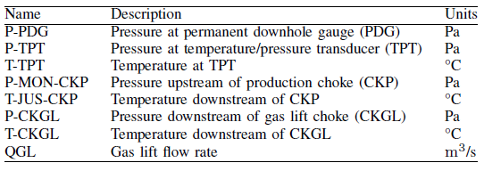
META DATA
Information on the dataset
CLASS LABELS
CODE | IDENTIFICATION
0 | Normal
1 | Abrupt Increase of BSW
2 | Spurious Closure of DHSV
3 | Severe Slugging
4 | Flow Instability
5 | Rapid Productivity Loss
6 | Quick Restriction in PCK
7 | Scaling in PCK
8 | Hydrate in Production Line
10x | Transient to state x
FEATURES LABELS

Slide 8
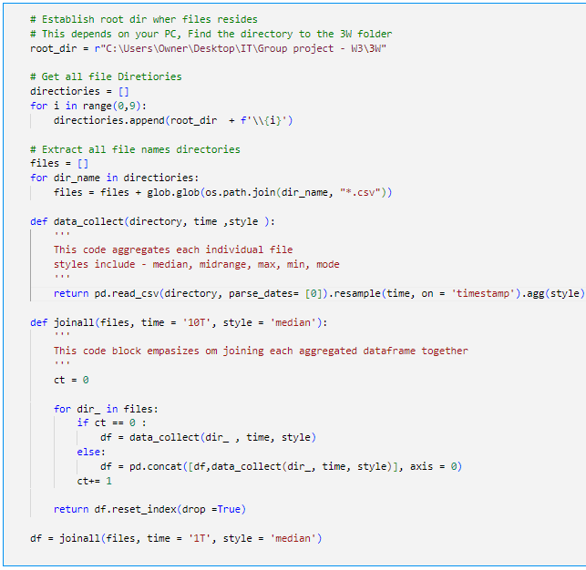
DATA IMPORTATION

Slide 9
DATA CLEANING AND EDA
FIX MISSING DATA
Find missing data and fix all issues by
dropping rows, columns or filling null values
CHECK FOR WRONG VALUES
Find and remove class that could have been
Created by the aggregation
OUTLIER DETECTION
Find and fix outliers that could probably skew our model
FEATURE EXTRACTION
Create Classes(Class type)
4
3
2
1
5
DATA VISUALIZATION
Show data distribution with visualization

Slide 10
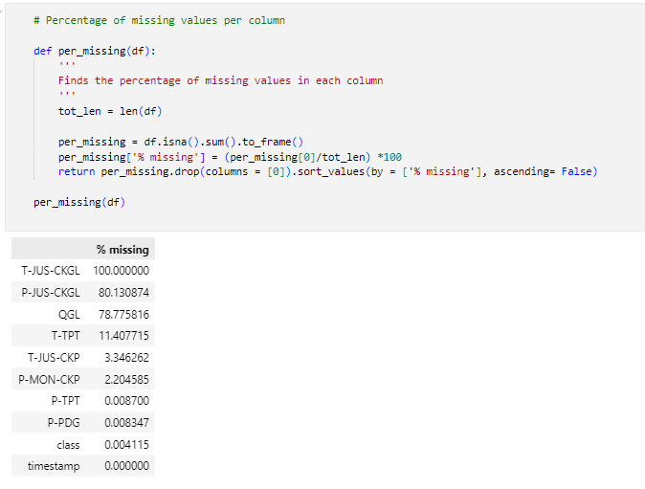
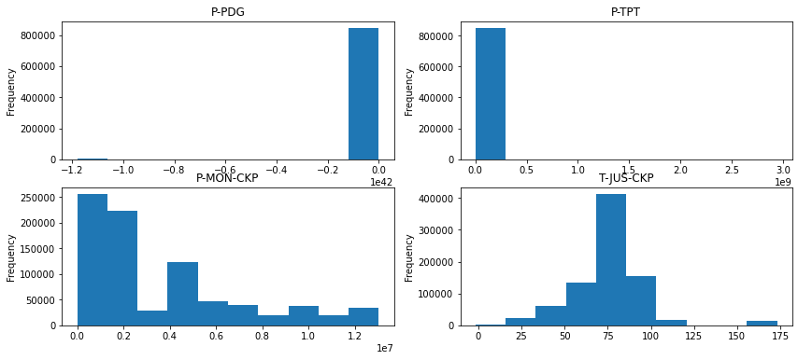
DATA CLEANING
Outlier Detection
Missing values
There are 3 columns with a lot of null(>50%)
P-JUS-CKGL
T-JUS-CKGL
QGL
Solution – Drop Columns
<1% Null < 15%
T-TPT
P-MON-CKP
T-JUS-CKP
Solution – Drop Columns
OUTLIERS DETECTED
Pressure at Permanent Downhole Gauge
Pressure at Temperature and Pressure Transducer

Slide 11
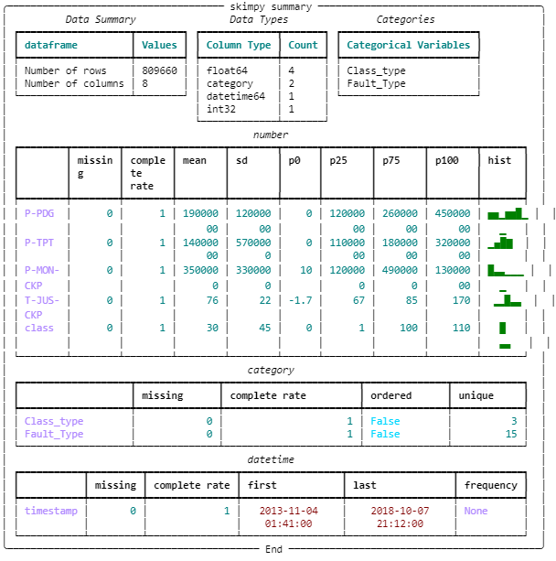
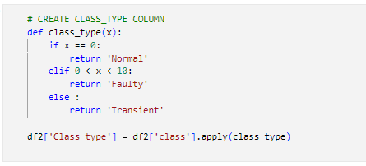
FEATURE EXTRACTION
CLASSIFY CLASS
Classify class into
Normal (0)
Faulty (1 – 9)
Transient (>100)

Slide 12
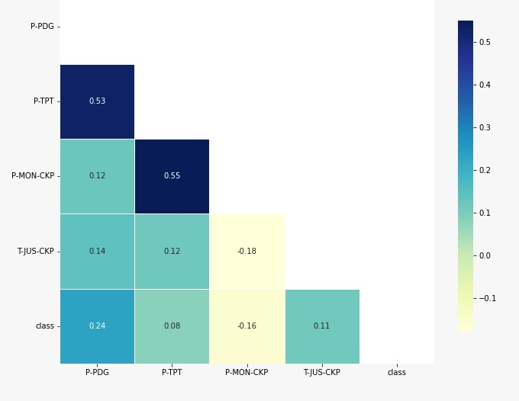
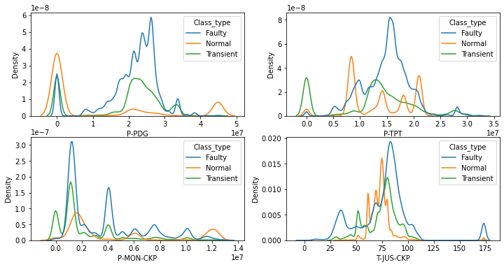
EXPLORATORY DATA ANALYSIS
Kernel Distribution Estimate visualizing the distribution of observations in a dataset
Relationship between features

Slide 13
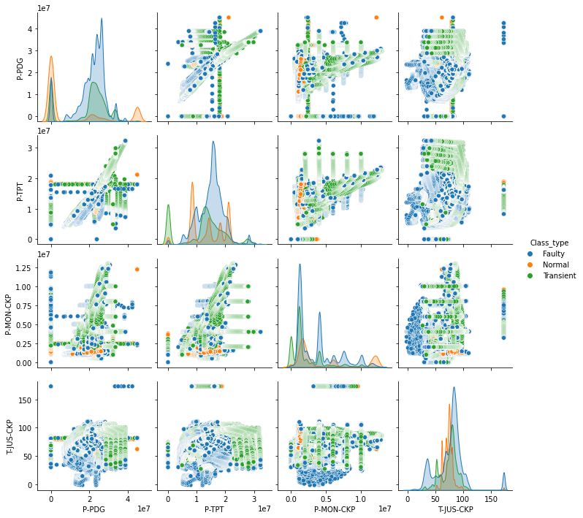
PAIRPLOT
Showing relationship between features

Slide 14

MACHINE LEARNING WORKFLOW
MODEL DEVELOPMENT
Develop the model to fit chosen architecture
Define Losses and Metrics
Train model on data
MODEL DEVELOPMENT
MODEL EVALUATION
MODEL EVALUATION
Evaluate Model on chosen criteria
Check Performance
HYPERPARAMETER TUNNING
HYPER PARAMETER TUNNING
Tune hyper-parameters To attain the best models

Slide 15

MODEL PIPELINE DEVELOPMENT
NORMAL(0)N
INPUT
FAULTY(1)
MODEL_1
(Predicting the class type )
MODEL_3
(Predicting the Fault type )
TRANSIENT(2)
Training 60%
Testing 20%
Validation 20%
MODEL_2
(Predicting the transient type )

Slide 16
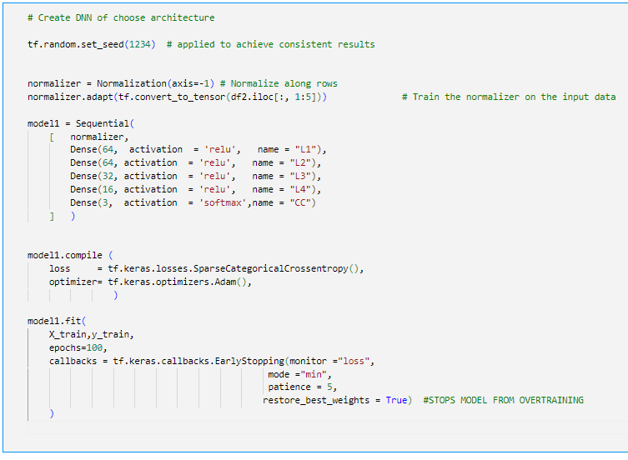
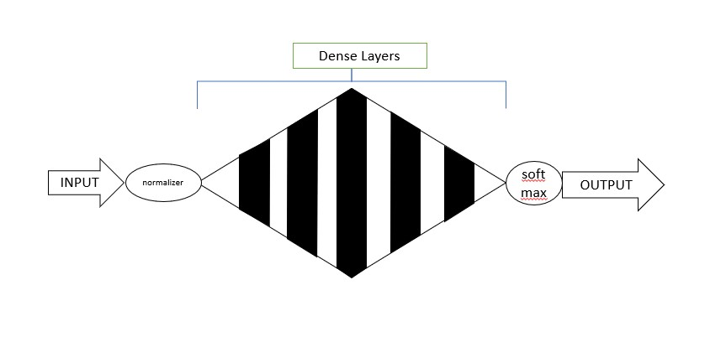
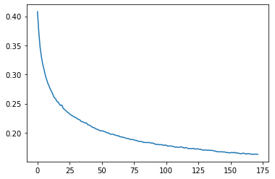
MODEL DEVELOPMENT
MODEL ARCHITECTURE
LOSS ON TRAINING

Slide 17
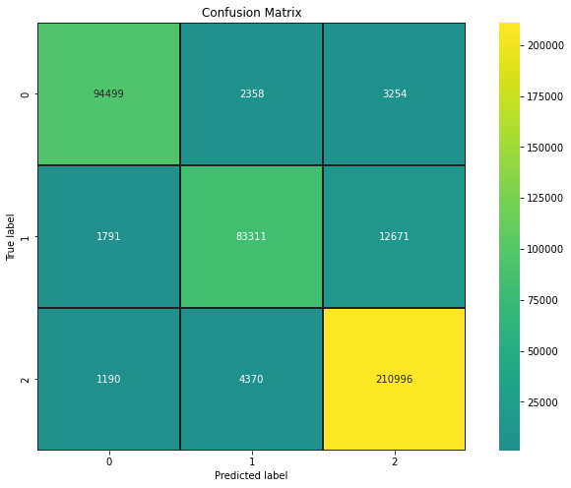
MODEL EVALUATION
Model Performance
Model Parameters
No. of hidden layers – 5(64,6,32,26,3)
Batch Normalization - False
Normalizer - True
Dropout - False
Activator - relu ‘Hidden layers’
-SoftMax ‘output’
Loss - SparseCategoricalCrossentropy
Optimizer - Adam
Callbacks - True

Slide 18


MODEL PERFORMANCE
ACCURACY-
Percentage of predicting the actual labels
F1 SCORE $\frac{TP}{ TP+0.5(FP+FN)} ∗100$
It is the harmonic mean of precision and recall
TP – True Positive
FP – False Positive
JACCARD SCORE
Statistic used for gauging the similarity and diversity of sample sets
TEST SET
 | ACCURACY | F1 SCORE | JACCCARD SCORE
MODEL 1 | 92.695% | 92.679% | 86.469%
MODEL 2 | 95.643% | 95.737% | 91.959%
MODEL 3 | 99.248% | 99.252% | 98.524%
VALIDATION SET
 | ACCURACY | F1 SCORE | JACCCARD SCORE
MODEL 1 | 92.808% | 92.793% | 86.664%
MODEL 2 | 95.632% | 95.727% | 91.901%
MODEL 3 | 99.213% | 99.219% | 98.462%

Slide 19
CONCLUSION
Model 1 performs moderately with >90% accuracy in all evaluation metrics.
A large percentage of this was due the model predicting more Transient Conditions as Faulty.
Model 2 Performs better with >95% accuracy in Classifying Transient Condition. Its flaw spans from the model having difficulty in differentiating the transcendence from an Normal condition to either Abrupt Increase in BSW and Scaling in PCK.
Model 3 preforms almost perfectly in predicting Faulty conditions with an accuracy of >99%. Its fault spans greatly from the same error as model 2
It is obvious that Abrupt Increase in BSW and Scaling in PCK have overlapping features.
Above all the model works well.

Slide 20

Thanks！
THANKS FOR YOUR ATTENTION

